Slide 1
Chronic Pelvic Pain
PD Dr. med. Daniel S. Engeler
Head
Department of Urology
Interdisciplinary Pelvic Floor Centre
Cantonal Hospital St. Gallen
School of Medicine, University of St. Gallen (MED-HSG)
Switzerland
daniel.engeler@kssg.ch

Slide 2
Conflict of Interest Disclosure
I have the following potential conflicts of interest to report:
Honoraria or consultation fees: Eli Lilly, Janssen-Cilag, Astellas, Curatis
Company speaker honoraria: Medtronic, GSK
Trial participation: Medtronic

Slide 3


Chronic pelvic pain: What are we talking about

Slide 4
CPP Introduction
In the past: focus on periphery (inflammation, infection)
Animal and clinical research: many of the mechanisms based within the CNS
Peripheral stimulus may initiate -> self-perpetuation as a result of CNS modulation
„Pain is an output of the brain“

Slide 5
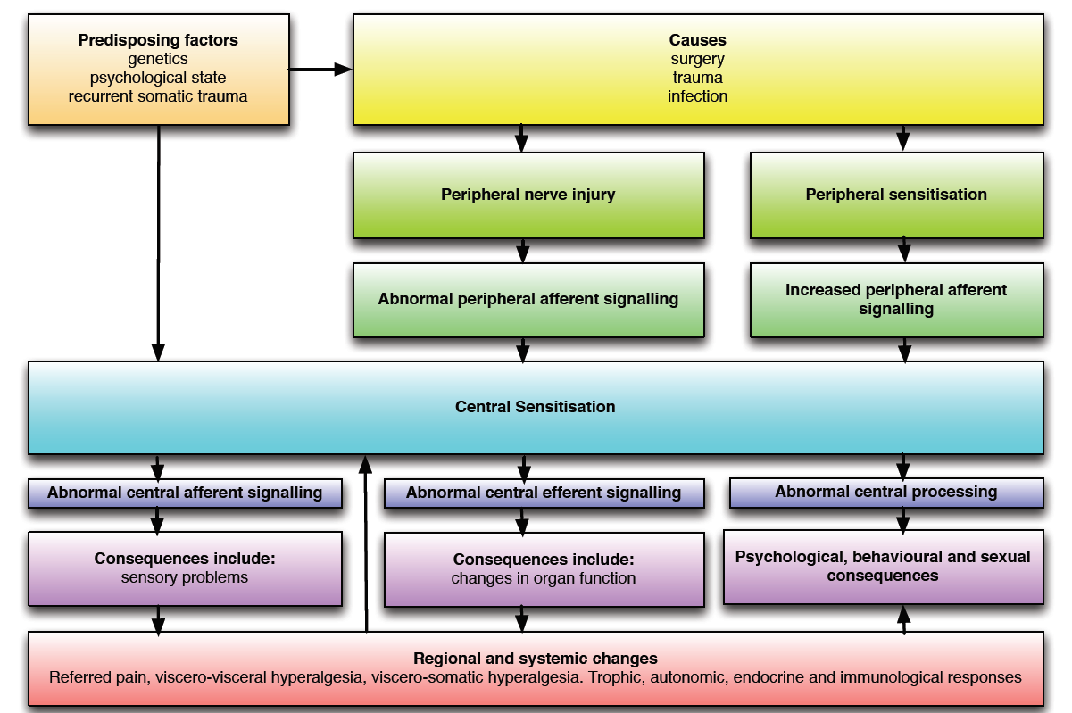
Pain and the Brain

Slide 6
Visceral vs Somatic Pain
 | Visceral | Somatic
Stimuli | Stretching Distension Poorly localized | Mechanical Well localized
Summation | Magnifying pain | Modest increase pain
Referred pain | Common | Rare
Innervation | Unmyelinated C-fibres, thin A𝜹 fibers | Wide range of fibers
Primary afferent physiology | Intensity coding | Two fibre coding

Slide 7
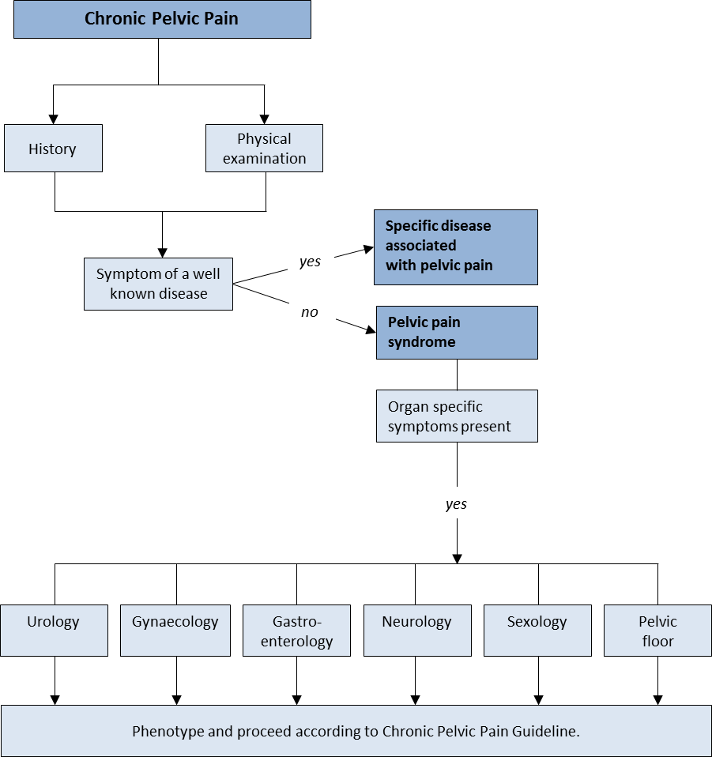
Algorithm
EAU Guidelines on CPP

Slide 8
Definition of a Pain Syndrome
Chronic pelvic pain syndrome is the occurrence of chronic pelvic pain
  when there is no proven infection or other obvious local pathology that may account for the pain.
  It is often associated with negative cognitive, behavioural, sexual or emotional consequences, as well as with symptoms suggestive of lower urinary tract, sexual, bowel or gynaecological dysfunction.
EAU Guidelines on CPP

Slide 9
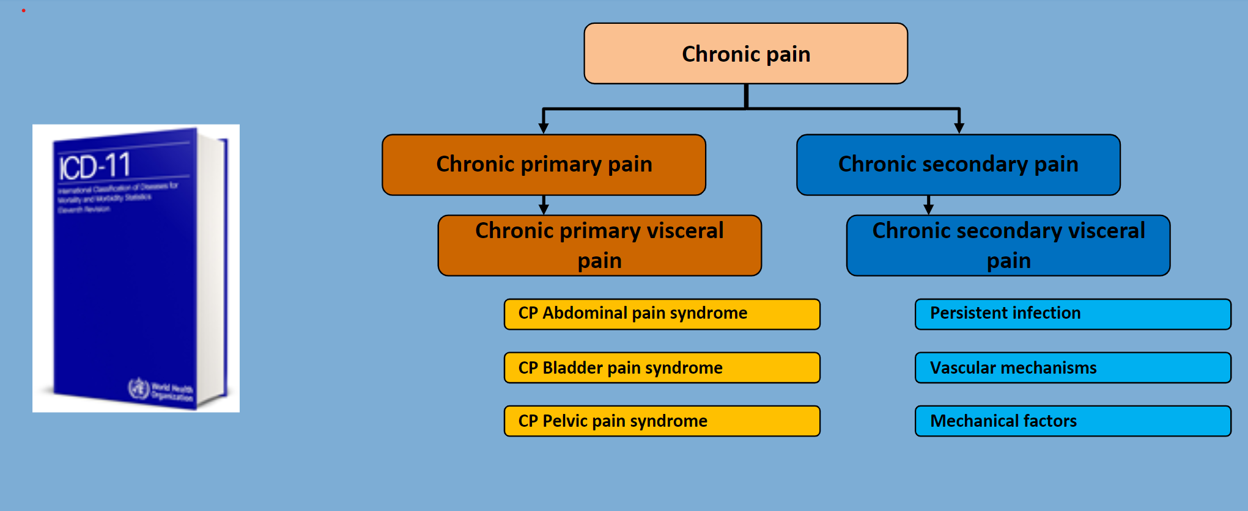
The Chronic Primary Pain Syndrome
  Chronic pain as a “Disease in its own right” (IASP, ICD-11)
ICD-11

Slide 10
Treatment Rationale for
Chronic Pelvic Pain

Slide 11
First Step:
Explain to the Patient what Chronic Pain is
He/She has to be informed about the nature of chronic pain
  Not just a symptom of disease
  Chronic pain as a “Disease in its own right” (IASP, ICD-11)
  Peripheral and central sensitisation
  Psychological components
Engeler DS et al. Eur Urol 2013

Slide 12
Second Step: Discuss Realistic Treatment Aims
Complete cure is only rarely reached
  Chronic pain should be relieved to a level patients can accept to live with
    e. g. pain of a VAS 6-7 to VAS 2-3
Try to target associated problems
  e. g. micturition problems, erectile dysfunction
Engeler DS et al. Eur Urol 2013

Slide 13
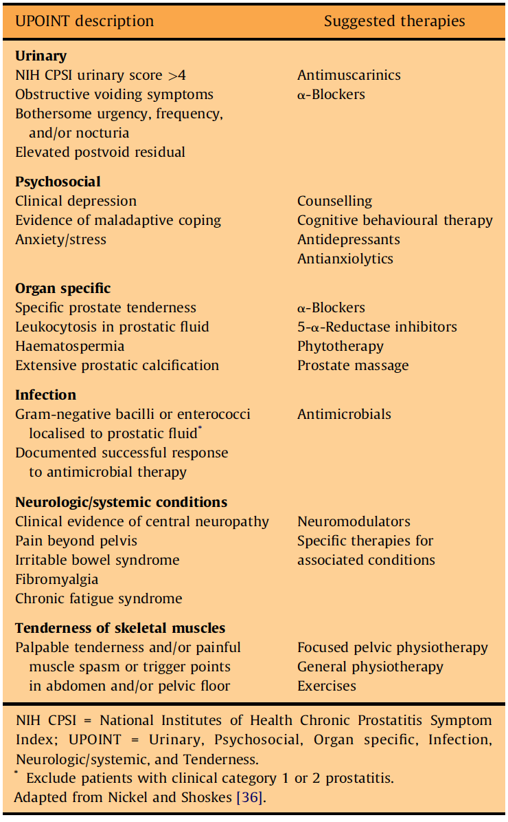
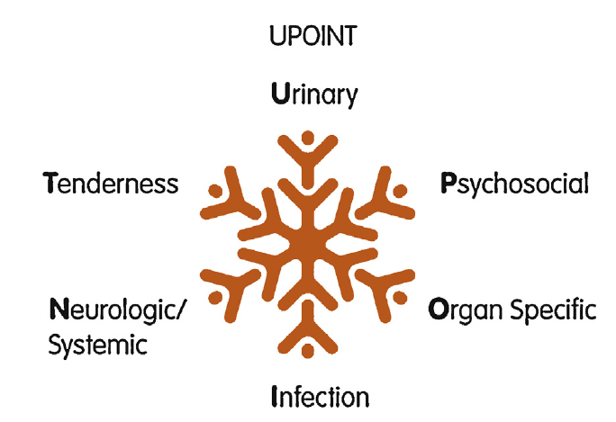
Third Step: Phenotype Targeted Therapy
Adapted from Nickel JC et al. Current Urol Rep 2009; 10:307-12 in Engeler DS et al. Eur Urol 2013; 64:431-9.

Slide 14
Forth Step: Early Interdisciplinary Management of CPPS
Like for the management of other chronic pain a holistic approach by a multidisciplinary team is recommended
Urology
Physiotherapy
Psychology
Pain Medicine
General Medicine

Slide 15

Do Not Repeat:
Negative Diagnostic Tests or Ineffective Therapy
The chance is very low that repeat diagnostics will lead to any new results or change management
Repeating ineffective therapy puts the patient to a higher risk of adverse effects and leads to higher cost
    Almost always it won’t work better the second time
      e.g. multiple antibiotic use leads to resistance
    Sometimes repeating ineffective therapy gives a wrong psychological signal to the patient
      e.g. “there must be some persisting bacteria causing the chronic pain”

Slide 16
Clinical Management of
(Primary) Bladder Pain Syndrome/
Interstitial Cystitis (P)BPS/IC

Slide 17
BPS/IC: Diagnosis
  Patient selection
    Chronic (>6 months) pelvic pain, pressure or discomfort perceived to be related to the urinary bladder
    Accompanied by at least one other urinary symptom (persistent urge to void or frequency)
  Exclusion of confusable diseases
    Medical history, physical, urinalysis/urine cultures, PSA (>40y), uroflowmetry, post-void residual
    Cystoscopy/Bladder-Bx
  Classification/phenotyping
Von de Merwe JP, Nordling J, et al. Eur Urol 2008; 53:60-7

Slide 18
Two Main Phenotypes
Hunner’s lesion
(HL)-BPS/IC
«classical» IC, ESSIC Type 3C
Non-Hunner’s lesion
(NHL)-BPS/IC

Slide 19
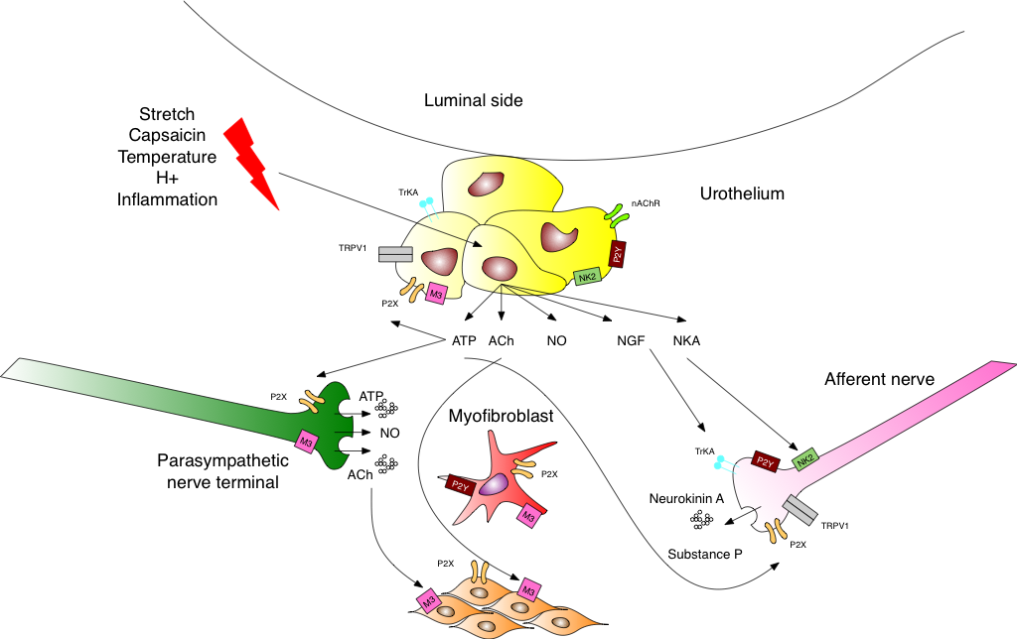
Peripheral Changes in (P)BPS:
Interconnection between physiological Urge and Pain
  Changes in chemical communication between urothelium and capsaicin sensitive C-fibre afferents may be responsible for afferent sensitisation
  Silent fibers (50-90%) become active
  Intensity coding of afferent fibers – increase in sensation leads finally to pain
    Urge ➔ Pain
Sun Y, et al. J Urol 2001;166:1951–1956

Slide 20
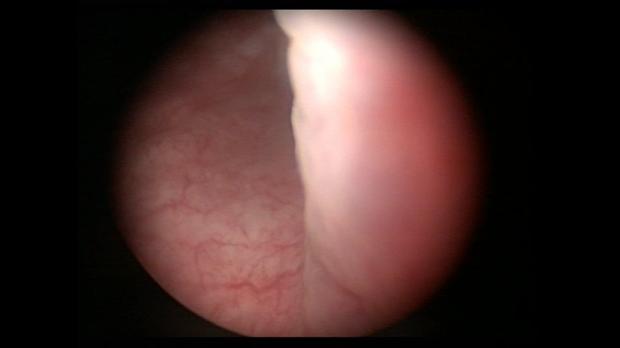
Rigid cystoscopy under general anaesthesia
Reddend mucosal areas with small vessels radiating toward a central scar ➔ Hunner‘s lesion

Slide 21
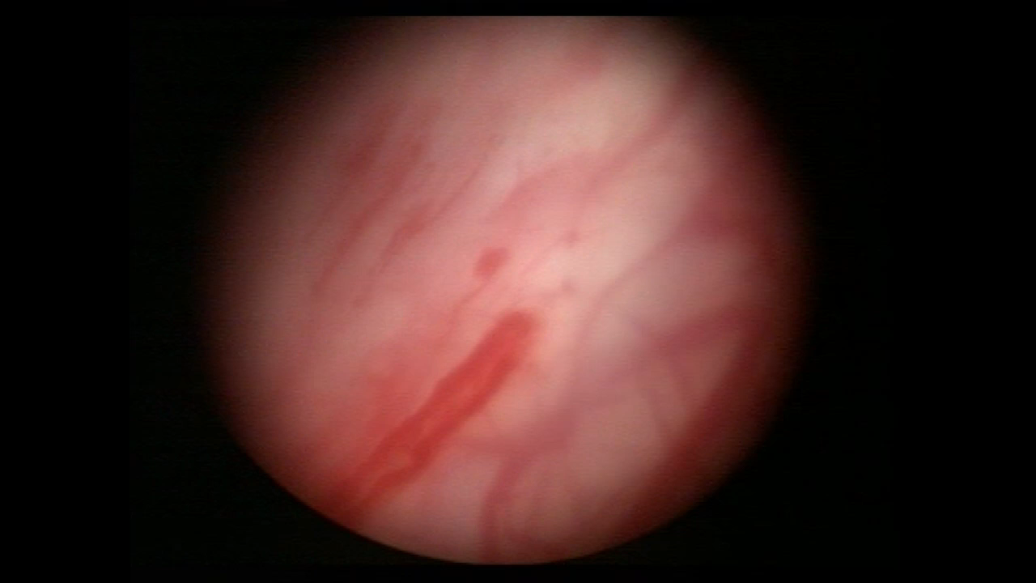
Rigid cystoscopy under general anaesthesia
Tears and oozing of blood (waterfall bleeding) after distention

Slide 22
Phenotypic Differences
Feature | HL-BPS/IC | NHL-BPS/IC | P
Mean Age [y] | 62 | 42 | <0.001
Mean voided volume [ml] | 206 | 289 | <0.001
Mean bladder capacity under anaesthesia [ml] | 459 | 743 | <0.001
Logadotir Y, Fall M, et al. Scand J Urol Nephrol 2012; 46:365-70

Slide 23
Treatment Rationale
    Similar basic approach
      BPS/IC should be treated as a chronic pain syndrome
      Patient information and expectations important
      Early involvement of a pain team
      Holistic approach
    Specialized treatment differs between phenotypes

Slide 24
Treatment Algorithm
HL-BPS/IC («classic»)
BPS/IC
Phenotyping
NHL-BPS/IC
TUR/Laser
Non-invasive therapy
Live style, physiotherapy, TENS
Oral agents
Inadequate Response
Inadequate Response
Adeqate Response
Follow-up on demand
Continue/repeat effective treatment
Intravesical therapy
PPS, hyaluronic acid, chrondroitin sulphate, EMDA
Inadequate Response
Last resort: Surgical resection
Refractory debilitating symptoms
Late stage disease
Small capacity bladder
Experienced team
Pain Team
Multimodal Pain Therapy
Botulinum Toxin
Sacral/Pudendal Neuromodulation
Inadequate Response

Slide 25
Non-invasive/Conservative Therapy
    Treatment should be tailored to the individual patient and phenotype
    Live style/behavioural changes
    Physiotherapeutic approaches targeting pelvic pain and pelvic floor dysfunction
    Psychological interventions directed at pain itself or adjustment to pain
    Oral medical therapy
      Amitriptylin
      Pentosane polysulfate

Slide 26
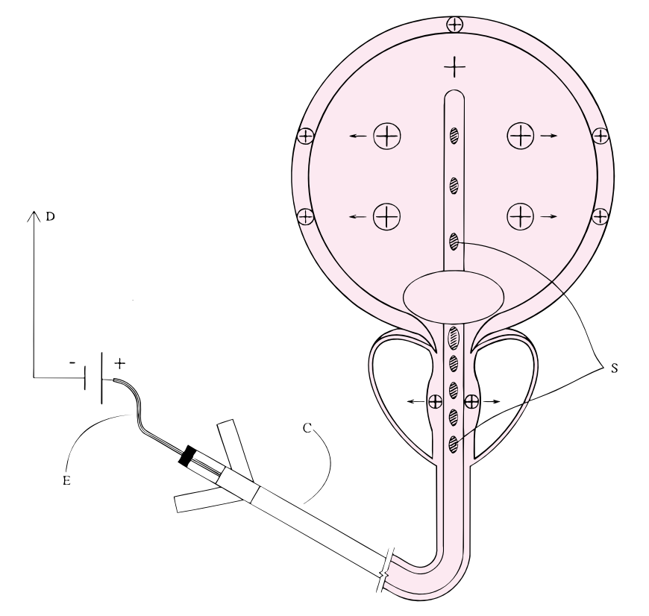
Intravesical Instillations
    In use for about 25 years
    For local anaesthesia or GAG-layer replenishment
    Different compounds and regimens (on and off-label use) including local anaesthetics, heparin, pentosane polysulfate, hyaluronic acid, chrondroitin sulphate
    Electromotive Drug Administration (EMDA) may be used for better penetration
    Overall only weak recommendation for their use but should be tried before proceeding to more invasive treatment options
EMDA
Madersbacher H, et al. Neurourol Urodyn 2013; 32:9-18
Fontanella UA, et al. BJU 1997; 79: 414-20

Slide 27
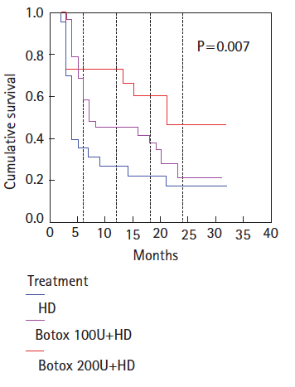
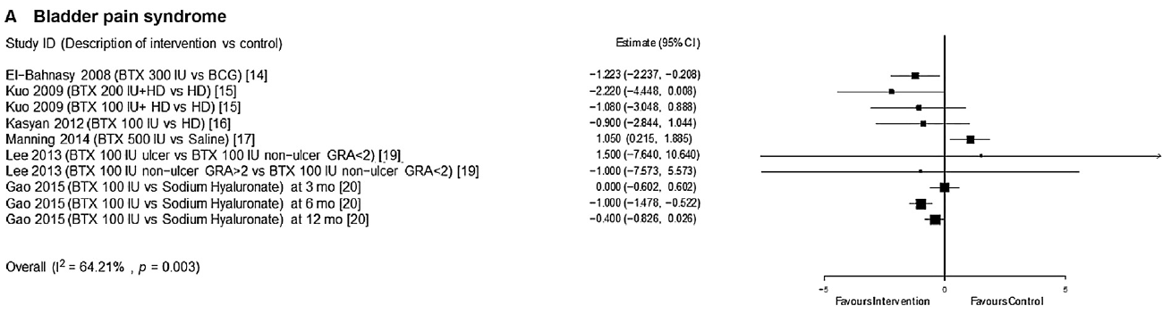
Intradetrusor Botulinumtoxin A
Forest plot of changes in pelvic pain (VAS)
Treatment success
BTX A ➔ Neuromuscular transmission, Afferents?
Several studies available (incl. RCTs and SR/MAs)
Conclusions
Intravesical BTX injections might offer significant improvement in bladder pain symptoms, daytime urination frequency, and MCC for patients with refractory BPS/IC
Kuo HC, et al. BJUI 2009;104:657-61
Wang J, et al. Med Sci Monit 2016; 22:3257-67
EAU CPP Guideline panel SR, Parsons BA, Engeler DS et al Eur Urol Focus 2022;8:320-338

Slide 28
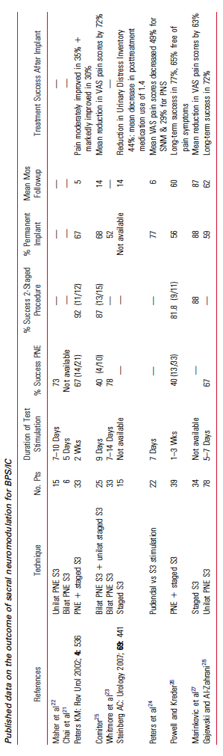
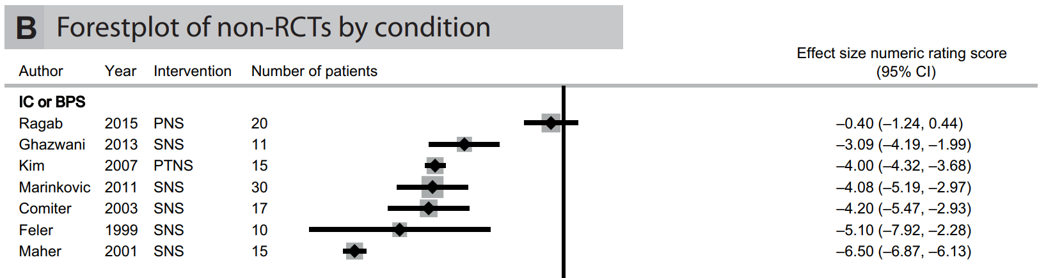
Electrical Neuromodulation
Systematic Reviews on Published Data on Outcome of SNM in BPS/IC
Conclusions
Promising results of small series, but overall insufficient evidence to determine the role of SNM ➔ Larger prospective trials with long-term evaluation needed
SNM may be a treatment option in cases where reversible functional problems exist and noninvasive therapy was ineffective
Marcelissen T et al. J Urol 2011; 186:387-93
EAU CPP Guideline panel SR, Cottrell AM,Engeler DS et al Eur Urol Focus 2020;6:559-71

Slide 29
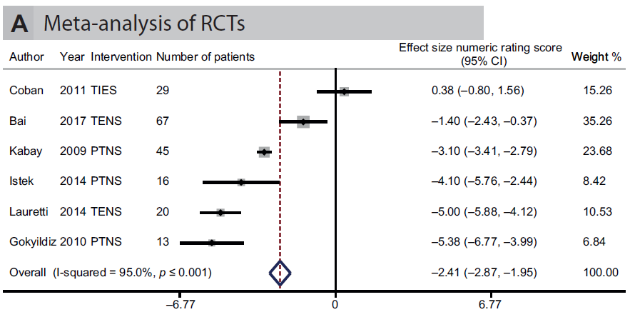
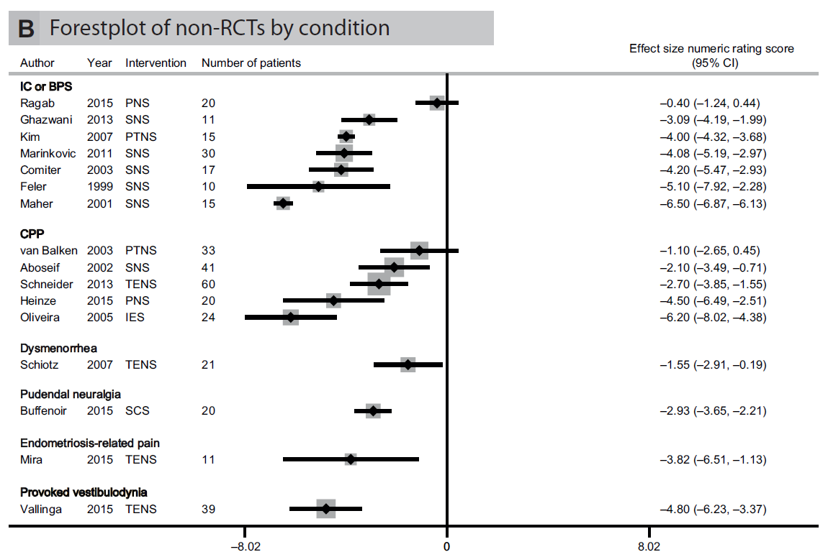
Electrical Neuromodulation for Chronic Pelvic Pain
    “Neuromodulation may provide an effective treatment option in patients with CPP refractory to standard treatment, reducing pain and improving QoL with an acceptable rate of complications…”
EAU CPP Guideline panel SR, Cottrell AM,Engeler DS et al Eur Urol Focus 2020;6:559-71

Slide 30
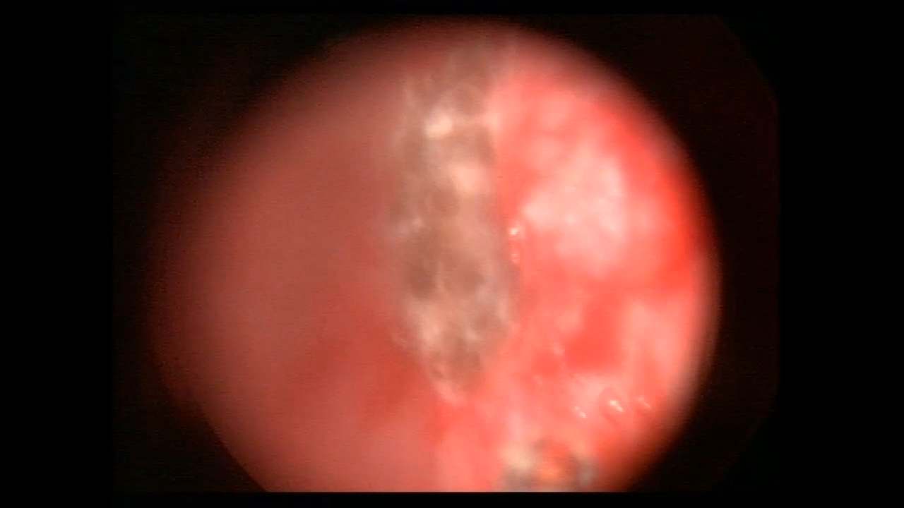
HL-BPS/IC: Laser Coagulation/Resection
    Larger series for transurethral resection or laser coagulation of Hunner’s lesions exist
    Symptom improvement in a high proportion of patients up to three years
    Can be repeated
Kerr WS. J Urol 1971; 105:664
Peeker R, et al. Urogynecol J Pelvic Floor Dysfunct 2000;11:290-5
Rofeim O, et al. J Urol 2001; 166:134

Slide 31
Cystectomy
    Different techniques
      Supratrigonal cystectomy with augmentation (HL-BPS/IC), subtrigonal cystectomy with orthotopic neobladder, cystectomy + ileal conduit
    Last resort, but may be very relieving for the patient with irreversible bladder dysfunction (“organ failure”)
    Only for experienced team

Slide 32
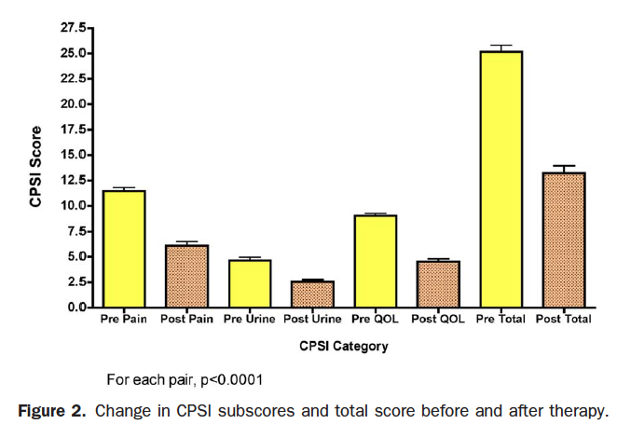
Therapy of Chronic Pelvic Pain Syndrome
Often no „standard“ therapy
Multimodal phenotype directed therapy more successful
84% improved
Shoskes DA et al. Urology 2010; 75:1249-53

Slide 33
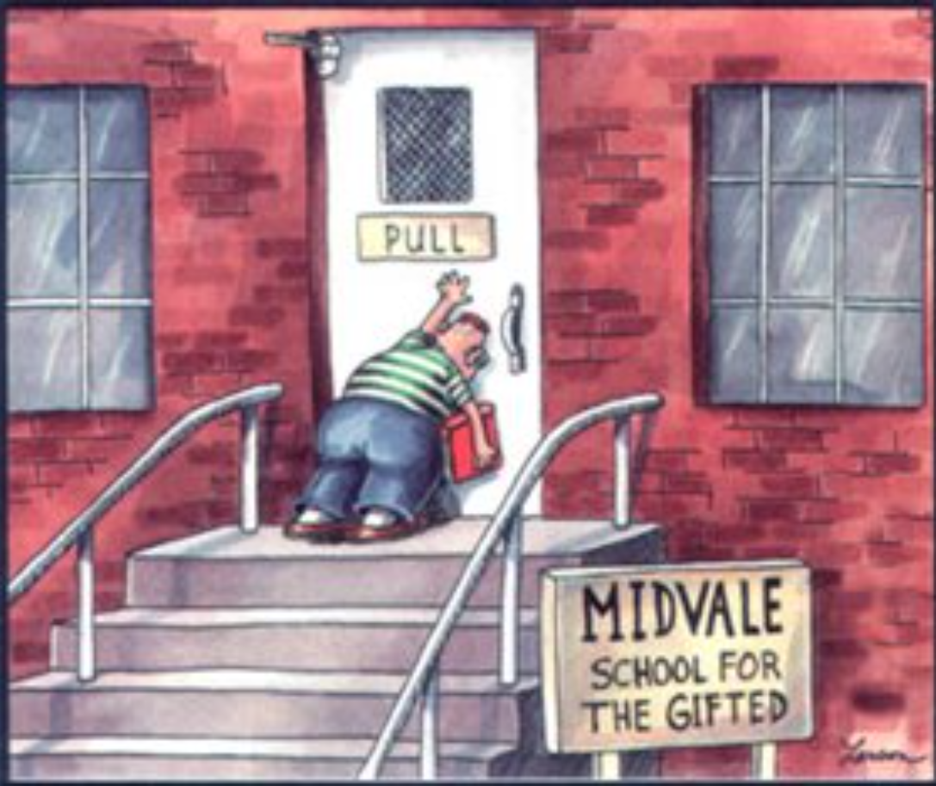
Conclusions
Managing patients with CPP remains a challenge
It is important to look at it as a PAIN SYNDROME
Explain to the patient what CPP is
Adapt treatment to the phenotype
Whenever possible: Use multimodal and interdisciplinary/interprofessional approaches
Thank you for your attention

